Slide 1
EARTHBOUNDS
There is no Planet B

Slide 2
Problem Definition
Mauritius is one of such small Islands that is still striving in the field of waste management. In Fact, among the different kinds of waste being landfilled, waste plastics which represent around 3% of the total waste produced in Mauritius, is one of the major components that presents a significant threat to the environment due to its non- biodegradable nature.
Earthbound’s main challenge and the goal was to find a regenerative way to use those plastic and turn them into reusable products that will be re used in the Mauritians daily lives.

Slide 3
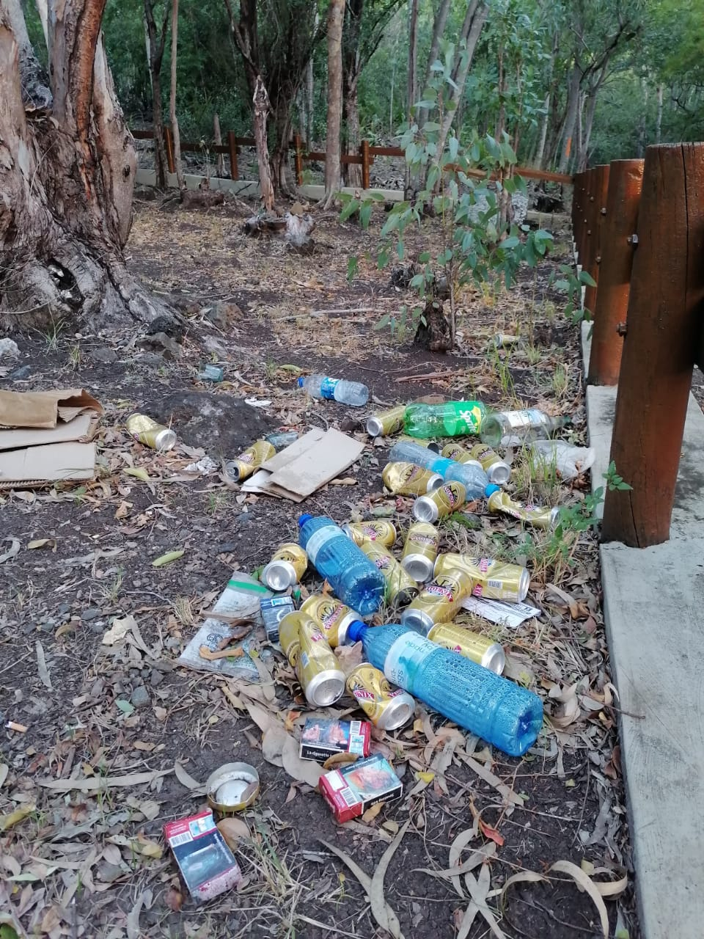
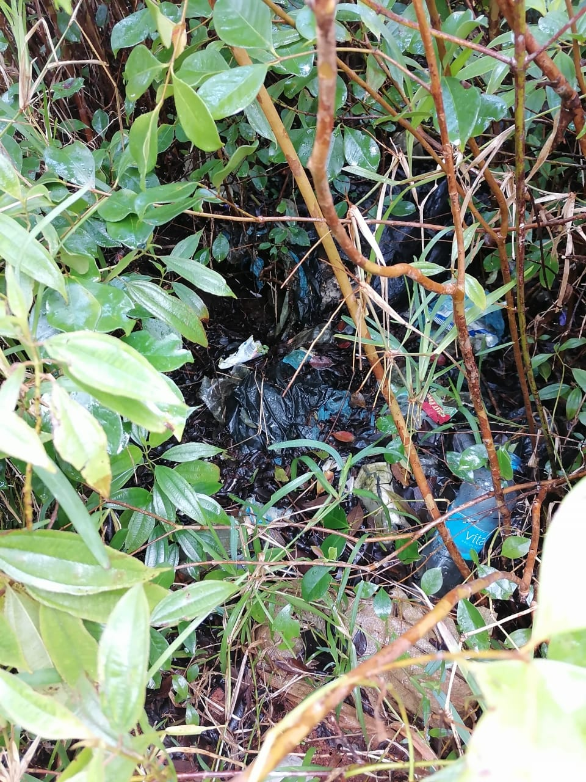
The Actual Situation

Slide 4
Data Collected/Analysed
For the collection of data, the “Registered Recyclers and Exporters as at 27 December 2019” from the Ministry of environment was consulted to make a shortlist of all the possible stakeholders that might be of help for our project
Moreover, we also tried collecting some primary data through our respective circle of influence and that was how we came to know of the existence of Precious Plastic. Once the shortlist was finalized and approved by all active members we started requesting meeting with the different stakeholders in order to have more in depth data.

Slide 5
Innovativeness of solution(s) selected
EarthBounds’ primary objective is the cleanliness of the general environment
The concept of “turning trash into treasures” will be the guiding principle of the group. Earthbounds’ secondary objective is to build a database of all the companies and individual who does recycling / upcycling in Mauritius.
The goal is to be the facilitator that acts as link between either the people who wants to dispose of re-usable waste or the “Environmental Patrol” and the companies and individuals who does recycling / upcycling.
THE ENVIRONMENT PATROL (EP)
The Environment Patrol will be a composed of both team members and Volunteers of the locality. The main duty of the EP will be to:
Spot the different places that needs cleaning.
Liaise with Earthbounds so as to plan next cleaning.
If upcycling will be done within the locality deliver the goods to respective up cyclers.
Sensitise the locality through open workshops – make use of recycled materials for greater impact.
Responsible to maintain the cleanliness of spots that do not fall in the control of the Municipality.
BOTTLE CAP UPCYCLE
The idea was to collect and shred bottle caps and PET bottles and mix them with clear melted plastic and get the mixture to be moulded into different commonly used items of our daily life.

Slide 6
Project Implementation Plan
Every week, tasks were given to each member and they were required to complete by the deadline given
The team, started sending mails to various companies and we got a response from PIM LTD, a plastic company situated at Port Louis. There, they explained us what can we do for our projects and what they can contribute to our team
We created a Facebook page, where we would express and share our ideas and other things. It is gradually getting more followers. As our ideas are reaching to more and more people, it can influence them and they can implement them in their daily life
The persons responsible for summarising every meeting and progress made on a regular basis. Throughout a WhatsApp group, they were giving summary to the team members who were absent. Every important messages were communicated through the group. In this way, every member in the team were updated from time to time
The other team members also contributed to the project in their every way possible so that the project could move forward. However, there were weeks where we were busy with office work or exams, where we had to concentrate on other things. Nonetheless, we had managed to catch up. Taking consideration of everyone schedule, we decided our eco hiking plan. We also decided how the hiking plan will be (transport cost, food, volunteers). Together, we came across an idea of collecting plastic caps to do DIY things so that we could sell.
Some team members contacted people they know so that they can help us to do our projects

Slide 7
EarthBounds Facebook Page
As of September 16, 2021, Earthbounds’s Facebook page has 300 followers and 296 likes)

Slide 8
Stakeholders Involved
NPCC
Our trainer and co-trainer
Team Earthbound
Friends and family from our locality
Precious Plastic Mauritius
Plastic Industries Mauritius
WeCycle Mauritius
Green Impact
Logger Mauritius

Slide 9
Stakeholders Involved
Stakeholders | How was they involved
Precious Plastic Mauritius | They were the main stakeholder involved which gave us the greatest insight, and product knowledge and proper shredder and also we agreed to sign an MOU between us so as to better know where they can help us and vice versa
Plastic Industries Mauritius | They gave us insight as to the way of going forward with the project and to the scale of it but also offered us bins made of recycled plastic
Polypets Recyclers Mauritius | They offered shredding facility
WeCycle Mauritius | They offered us to collect wastes from the different points that the EP were to set
Green Impact | They mainly contributed to enlighten us about the actual recycling procedures of the Market
Logger Mauritius | They Provided us with insight for the upcycling process

Slide 10
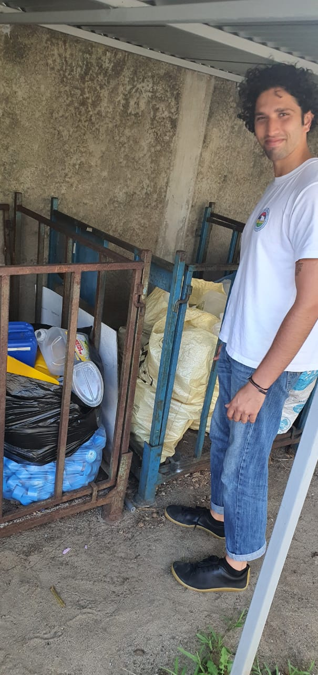
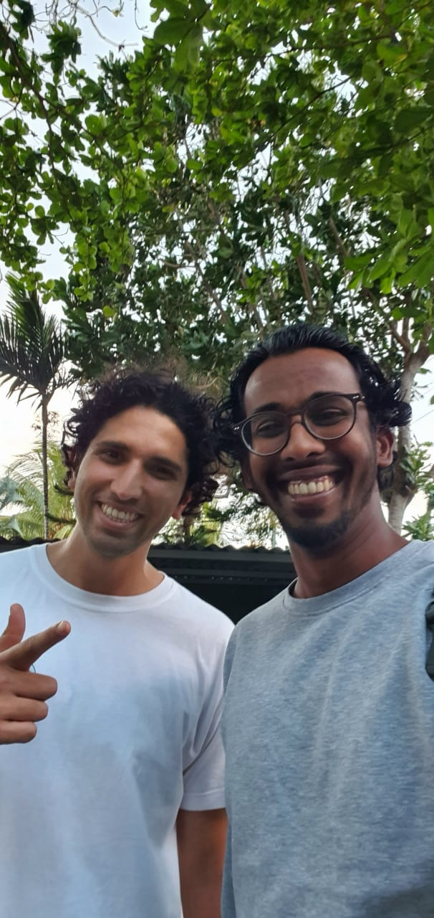
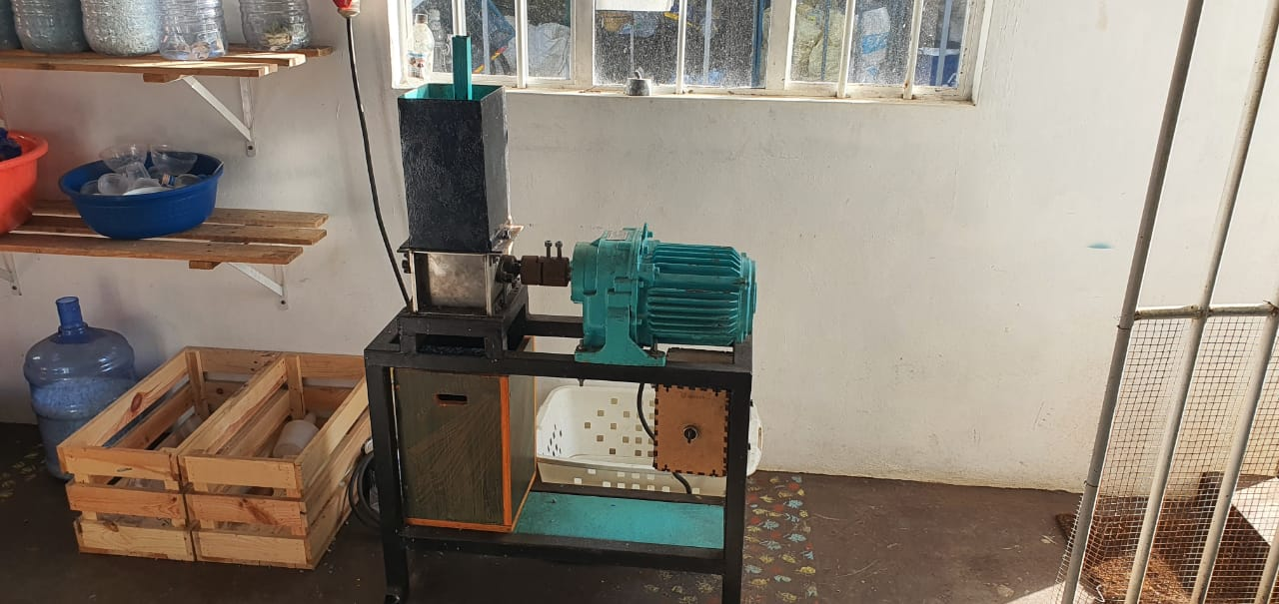

Slide 11
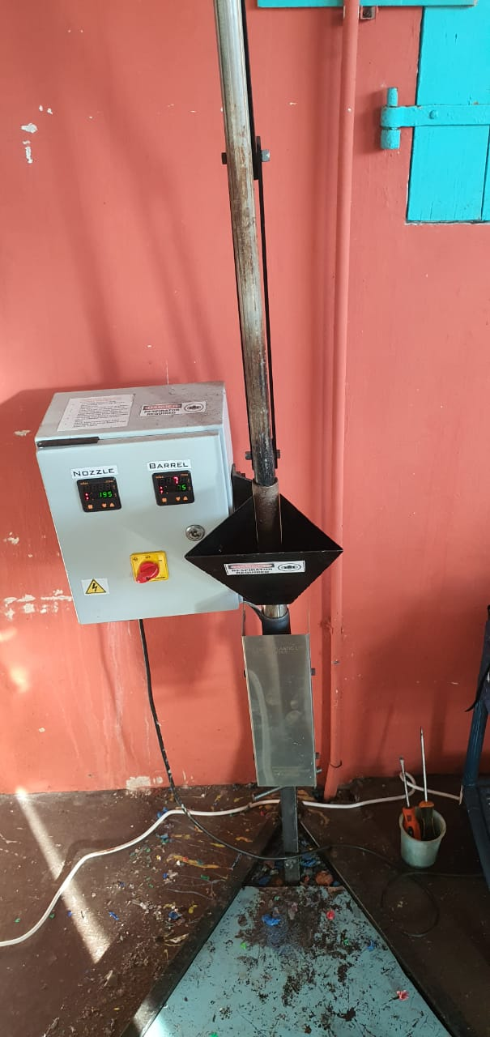
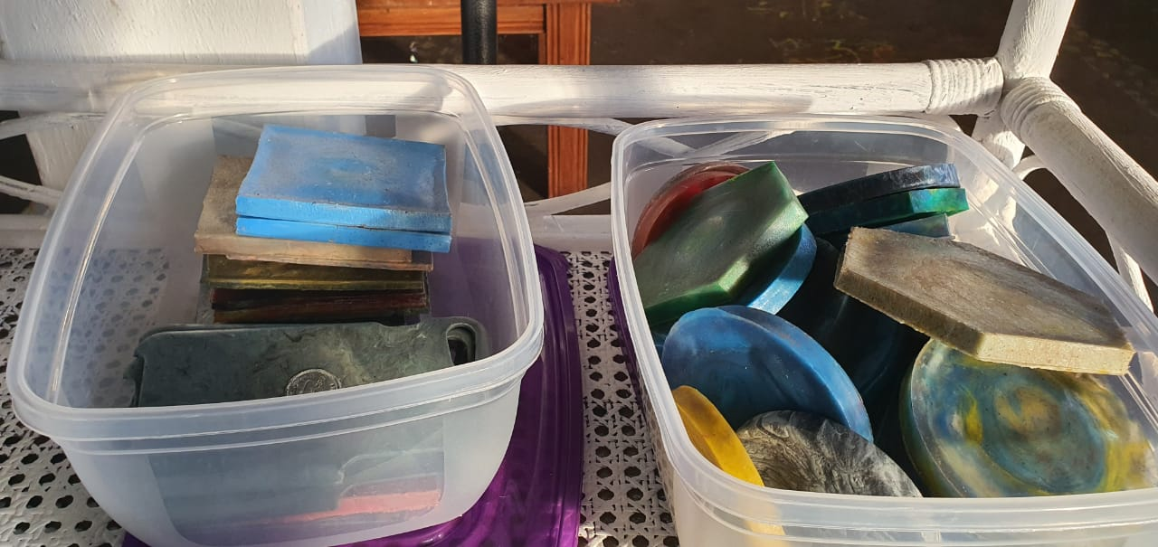
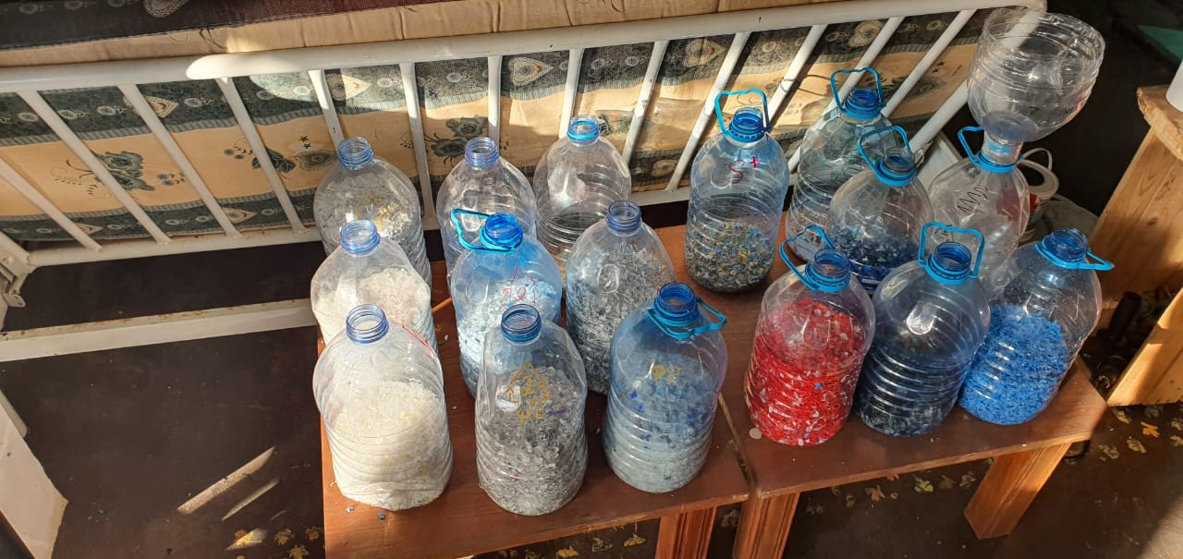

Slide 12
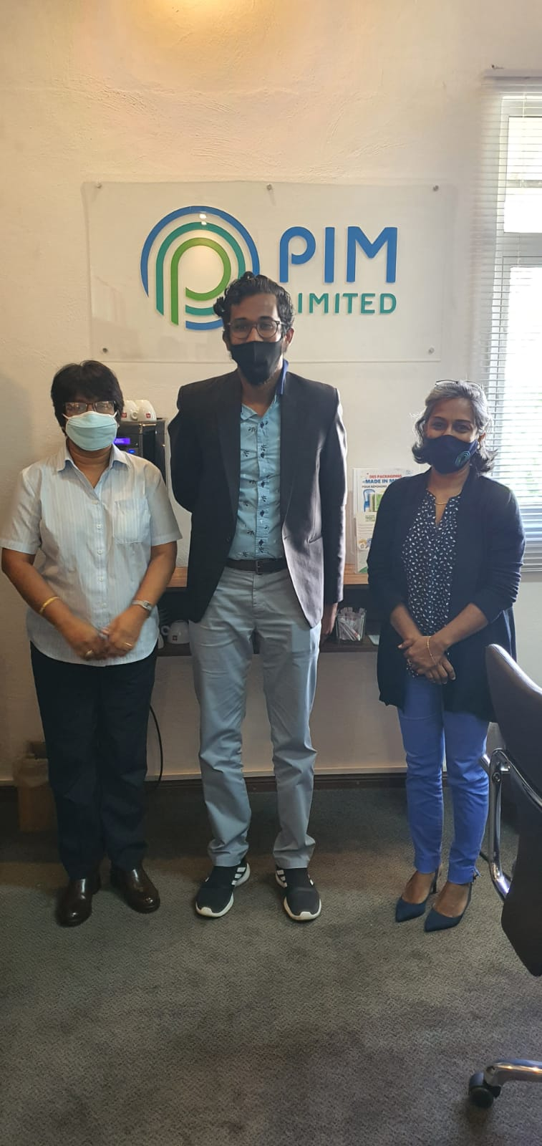
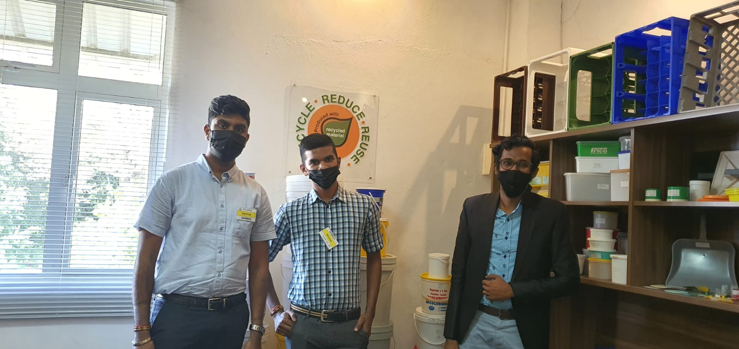

Slide 13
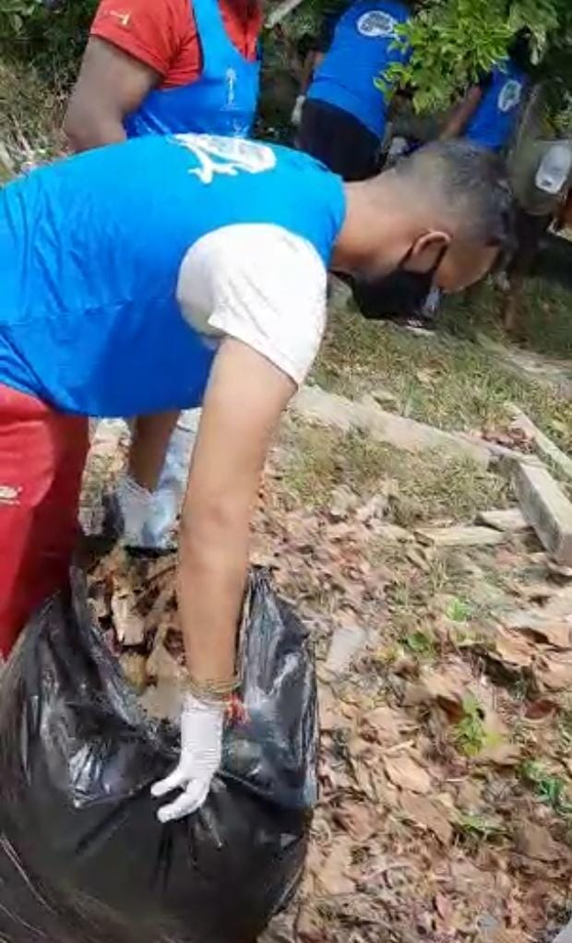
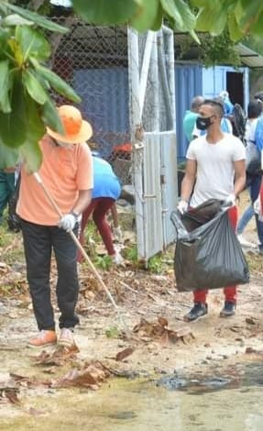
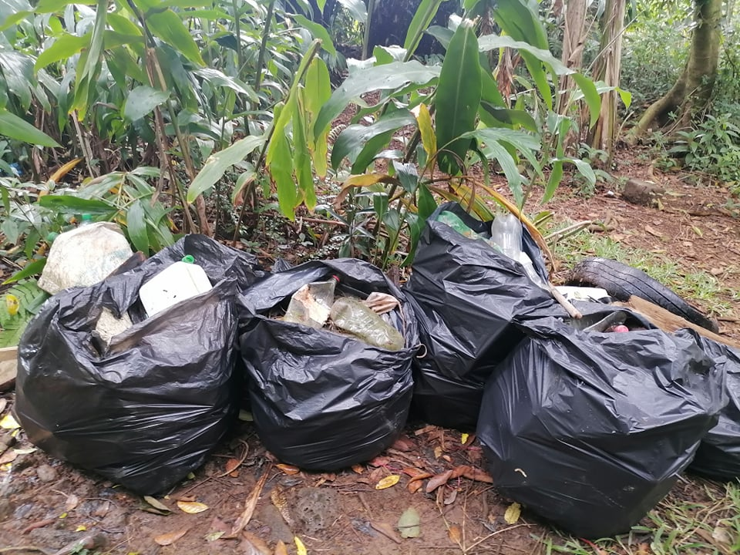
Actions taken by team members
Cleanups

Slide 14
Actions taken by team members
Site visits to evaluate the actual situation of some of the main places of interest

Slide 15
Actions taken by team members
Creation of a Facebook page for the group
Collection of bottles and caps to be recycled
Request and attend meeting with stakeholders to share ideas and discussion.

Slide 16
Difficulties & Challenges encountered
Need to convert the whole concept from Island Explorers and Re-adapt to EarthBounds
Due to the ongoing pandemic situation in Mauritius the original concept of the group which was to bring about the concept of "Eco-Hiking" as main concept had to be re formulated to be a secondary objective. The concept was to go out and visit and better every of the Natural treasures that Mauritius holds. Group activities being closely monitored the group had to change the concept. Moreover one of our member was positively tested to the Virus.

Slide 17
Difficulties & Challenges encountered
Group Split up
The Group split up was one of the principal turnoff of the group. After all procedures were discussed and approved by the group we came to know that the NLE requirement was to have only one co trainer per project and this was and still the main demotivating factor that we came across. Even more that with the split up came also dormant members.

Slide 18
Difficulties & Challenges encountered
Lack of interest from stakeholders involved
Polypets Recyclers ltd. Company with whom we met on the 08/09/2021. Where the employees was reluctant to help us since we approached the director instead of them as per their saying and they literally swept the floor to give us the flakes that we requested and obviously we got it with all its dirt and other waste.
Moreover we also faced unresponsiveness issues with one of the main stakeholders that was supposed to help us derive the final product and we are still trying to find another alternative.

Slide 19
Difficulties & Challenges encountered
Lack of interest and responsibility of members
Some members of the group were nearly not active at all during the whole course of the project and this seriously burden the other active members and despite that we managed but during the last stage of the project this really hit us hard since the last stage co-incided with internship period of the other active members and they had to take up their internship. The lack of interest and involvement of the other dormant members was really a heavy burden to bear by that time.

Slide 20
Difficulties & Challenges encountered
Talent Differences
Some members contribute more to a team than the rest of the team. The reason is not always that they feel responsible for the team, the share of their contribution depends on their individual talent and efficiency. But sometimes, these talent differences caused conflicts between team members.
Some members of the team were slower and less efficient than the rest. This decrease the overall productivity of the team and was frustrating for the high-performers of the team causing conflicts within the team. To avoid this, EarthBounds set goals that were based on their capability and skills.

Slide 21
Difficulties & Challenges encountered
Unavailability of the proper Technology
The main idea of the group concerning plastic recycling was to turn them into garments. But after market research and meeting with WeCycle Mauritius we came to know that such technology is not only unavailable but also so costly that all the firms that recycle plastic prefer to export their collected waste to South Africa where the machine is available.
Moreover, the only NGO that we found that recycles, upcycle and educate users as to the different alternative uses of plastic locally is Precious Plastic. The two main types of plastic treated by Precious Plastic is PP (Polypropylene Plastic), PE (Polyethylene Plastic), HDPE (High Density Polyethylene Plastic).

Slide 22
Difficulties & Challenges encountered
COVID_19 Pandemic
Unfortunately for us during the last stage of the project our Assistant Team Leader was also tested positive to the COVID-19 and this brought about a delay in finalizing and deriving the final product.

Slide 23
Ability to solve problem as a team
Need to convert the whole concept from Island Explorers and Re-adapt to EarthBounds
The group had to rethink of a whole new concept that would be more appropriate to the sanitary conditions of Mauritius. We conducted various online meeting and came up with the idea of recycling through DIY.

Slide 24
Ability to solve problem as a team
Group Split up
With great demotivation we had to part off with some of our members and the island explorers was thus split up into Eco Vengers and Earthbounds. We did the whole election process again and that was really time consuming.

Slide 25
Ability to solve problem as a team
Lack of interest from stakeholders involved
During debrief done on the same day that we met with Polypet Recyclers, we proposed to approach the NGO Precious Plastic to have a better product that we can use. It was then that the primary data search was initiated by the group.

Slide 26
Ability to solve problem as a team
Lack of interest and responsibility of members
We unfortunately could not persuade the dormant members so we decided to continue to move on with the active members but we did not part off with the dormant members since they had a death in their family we thought that as a group we should be supportive of each other and tried to understand their sufferings.

Slide 27
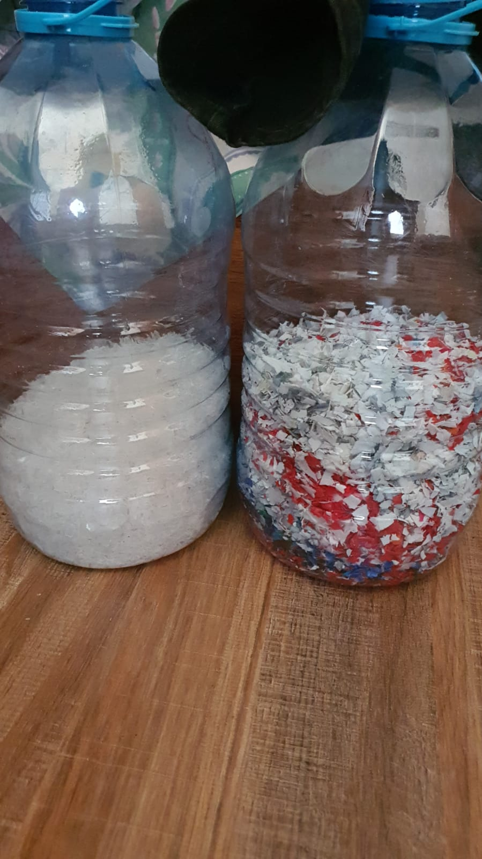
Results Achieved
We managed to raise awareness with the people in the places that we have visited and clean up several locations. Plastic bottles that were picked up by the team was given to Polypets Recyclers Mauritius for recycling, so that they can be re used by making other products like t-shirt and others.

Slide 28
Sustainability
Planning of other clean ups
Collaboration with other groups for clean ups and raising awareness
To reach a greater audience
Use shredded plastics to make jewelry

Slide 29
Thank you

