Slide 1
Geshna Boodhram Khilesh Paupiah
Ritesh Hemraz
Chelvin Ramsamy

Slide 2
Black Outs are still a reality
Notes:
Agenda

Slide 3
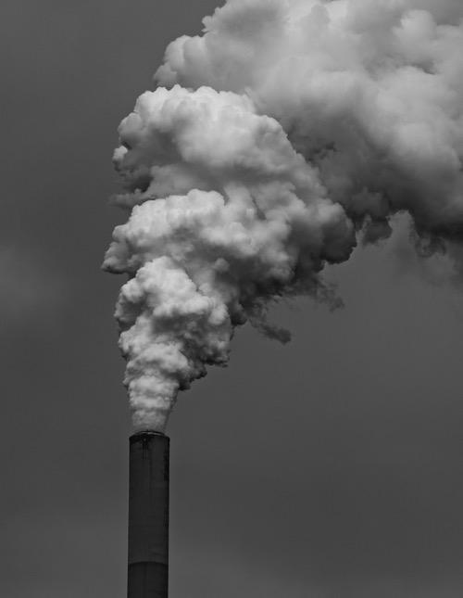
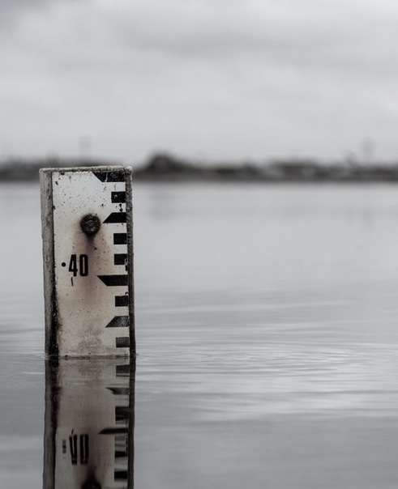
It’s Time to Make A Change!
We have toxic air quality as per the recommended ratings.
Burning charcoal or heavy oils consequences:
Climate change
Rise in sea levels, global warming.

Slide 4
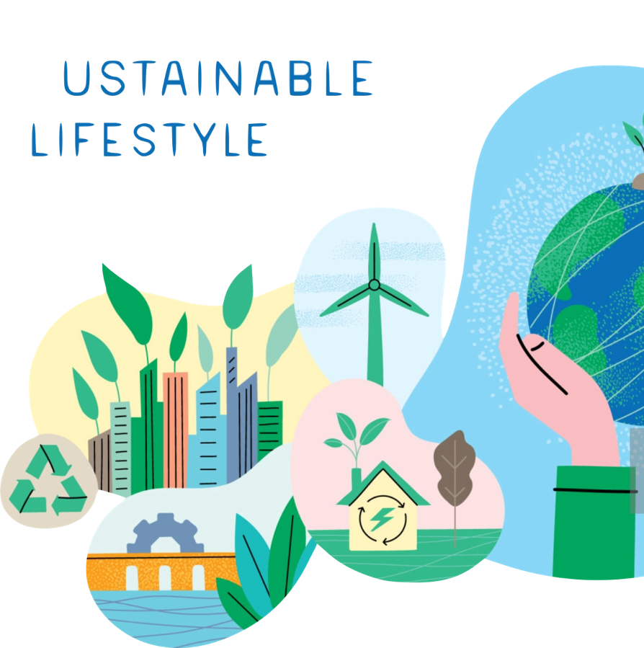
Our aims
& Objectives
Reduce the use of fossil fuels.
Exploit renewable energy sources.
Decentralise energy production.
Maintain balance within the ecosystem.
Create environmental awareness
We are also doing a couple of workshops and webinars to educate the youth on the matter

Slide 5
The Plan-Do-Check-Act Cycle
Plan
Do
A well-defined set of objectives is chosen to direct the framework for operations.
The whole endeavor is set into action and data is being collected along the way.
PLAN
DO
Act
ACT
Check
CHECK
Once identifies, measures are taken to improve upon the existing model.
The results are then analyzed thoroughly to assess what needs to be adjusted.

Slide 6
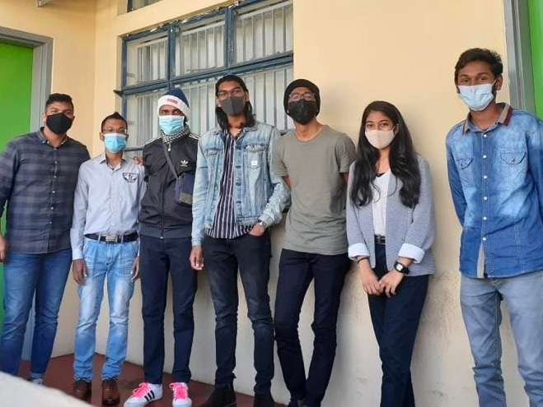
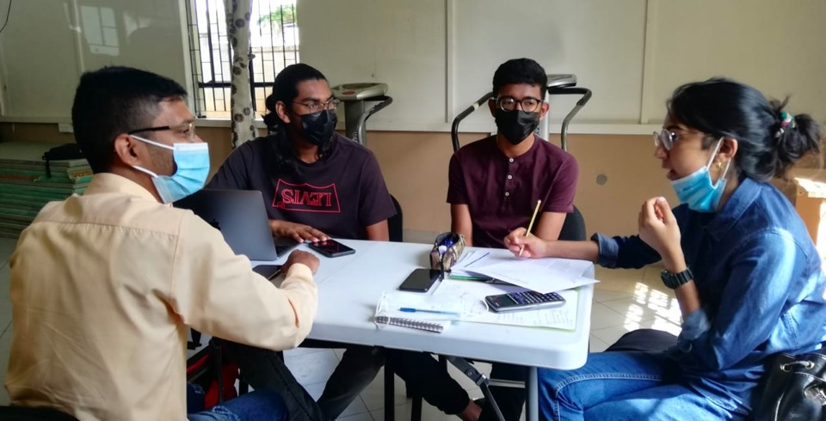
The Plan
Brainstorming
Discuss with experts in field
After, we proceeded to distribute and layout the workload load
One of our meetings at SYC

Slide 7
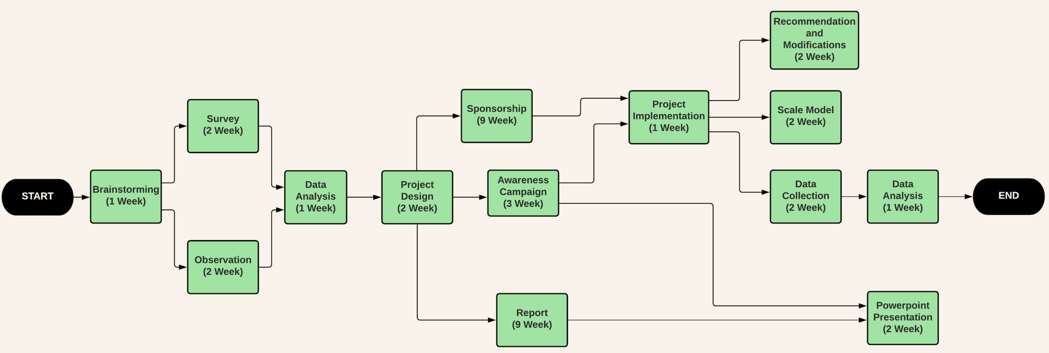
Pert Chart
Project’s timeline
Time management
Understand dependencies between tasks
Breaks down the individual tasks for analysis

Slide 8
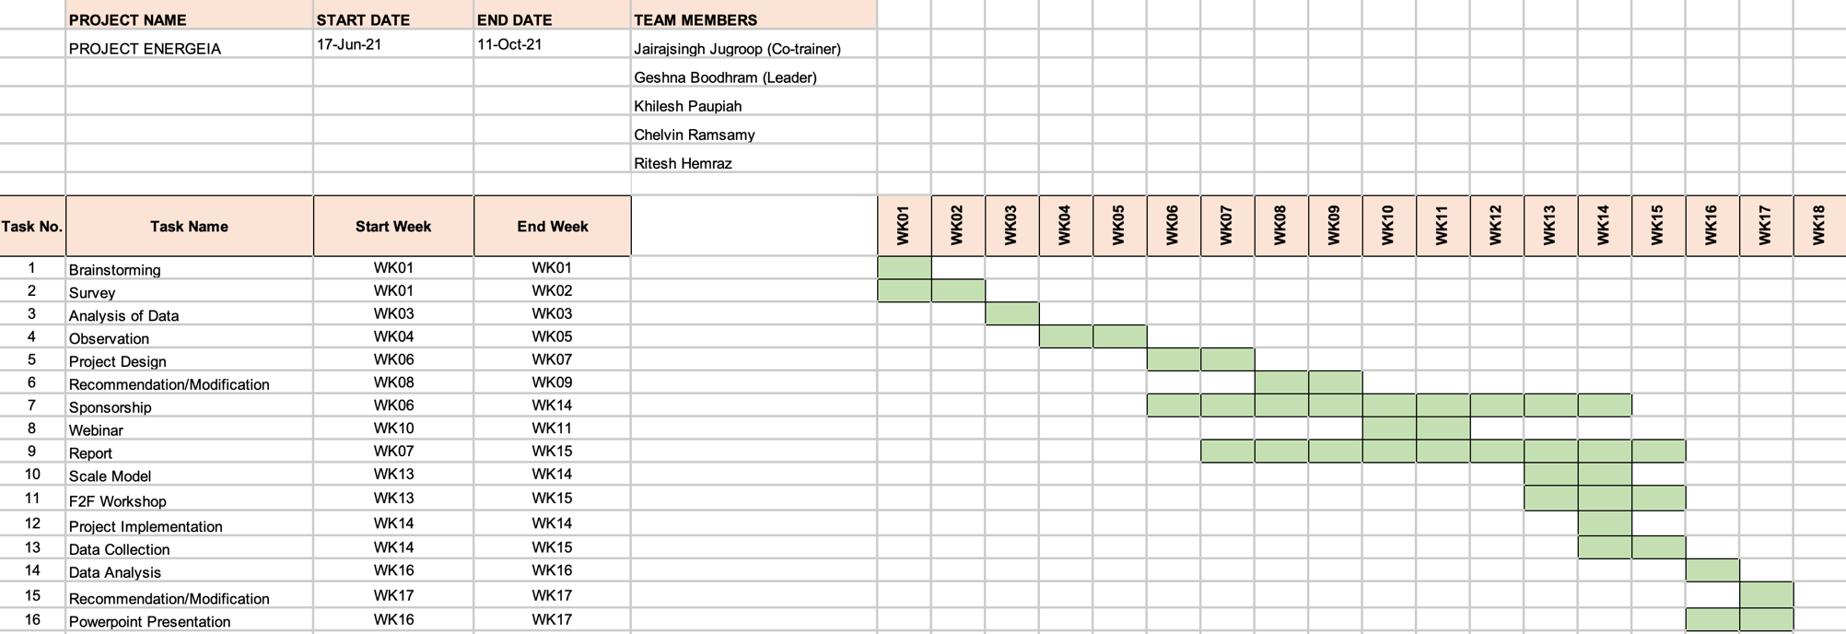
Gantt Chart
Picture our project against the time frame.
How long the project should take?
Determine the resources needed.
Plan the order in which each task should be completed.

Slide 9
Data collection & Survey
Interviewed people in the locality of Surinam and L’escalier.
Average domestic households 3 essential appliances: Refrigerator, Kettle, Microwave.
Average electricity units per average household
Interview
Survey

Slide 10
Observations
1
3
Save on utility bills
A healthier and greener looking locality.
2
5
Reduction of carbon footprint
Increase and grow curiosity among people.
3
The wind turbines fits perfectly the location.
6
Creates environmental awareness and educates the population.

Slide 11
Lack of education and awareness
Health Problems
Rise in sea water levels
Problem tree diagram
Overdependence on centralized grid
Impact on marine life (acidification)
Challenges in energy production
Land degradation due to mining
Rise in cost of fuel
Under exploitation of Renewable energy
Global Warming
Pollution

Slide 12
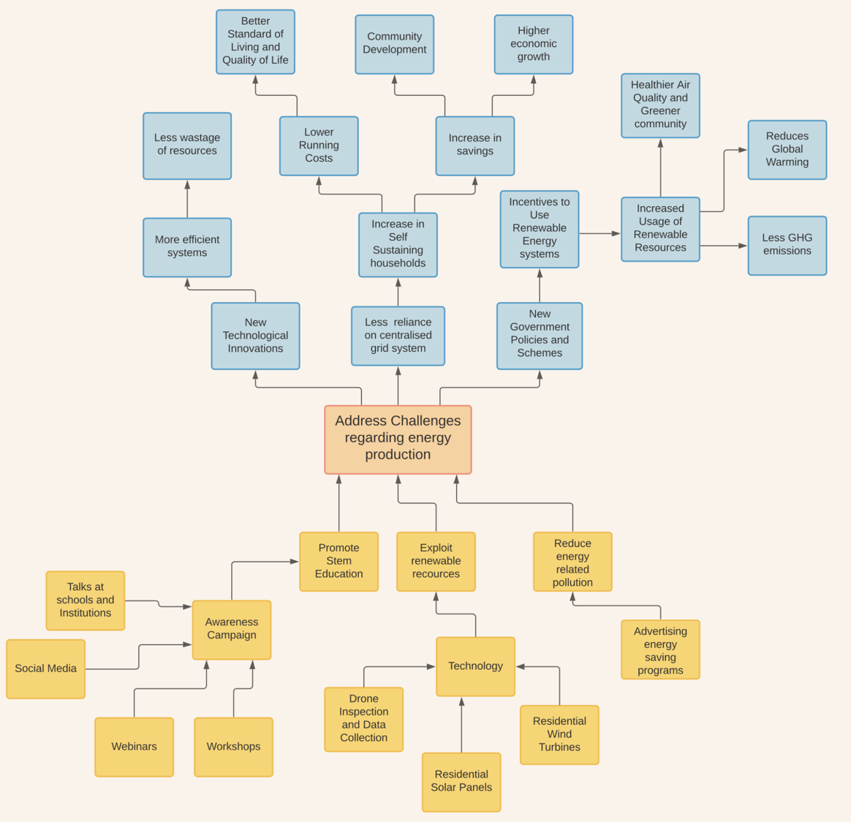
Solution Analysis

Slide 13
Do
Explored different designs at different scales
Meeting with multiple agencies for funding
Conducted educational campaign: webinar and seminar.

Slide 14
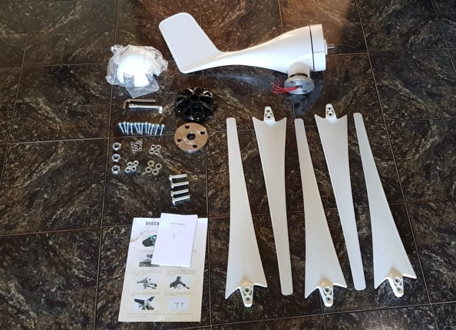
Our Proposed Model
When sun is strong and temperature is high, wind is weak & vice-versa
The Best of
Both Worlds
Hybrid ensures ongoing energy generation
Due to the covid situation there were delays on import

Slide 15
Why the Hybrid concept?
The Best of
Both Worlds
Solar
Wind
Combines different generation, storage and production technologies
Budgetary measure to phase 60% coal by 2030
Upfront investment with huge savings in the long run
Citizens become energy self-sufficient
Cheapest energy source standing at Rs22 per kWh
Smallest carbon footprint for electricity generation of 11g of CO2 emission per kWh
Electricity bill can be reduced by 50%

Slide 16
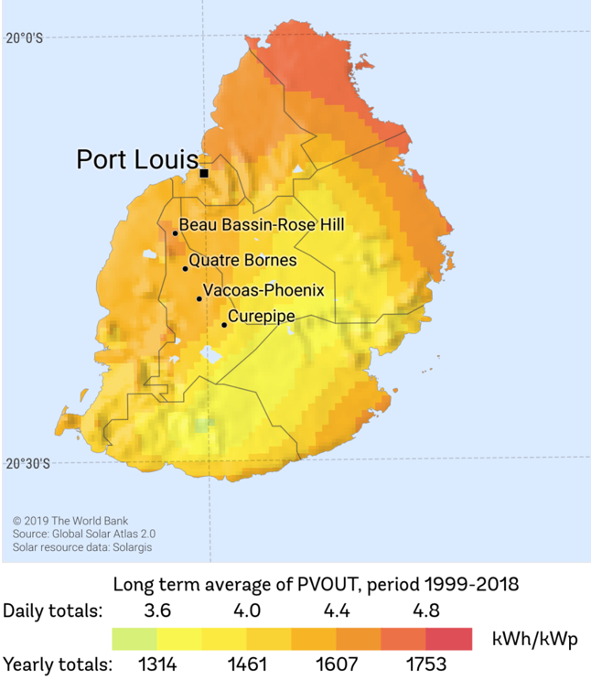
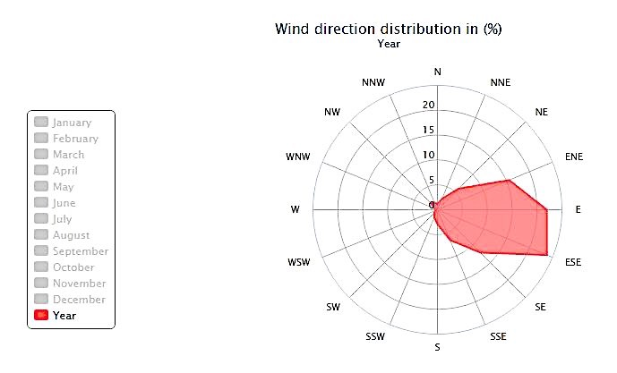
The ideal locations for a pilot project to produce a standardized result was in the south-east region.
Locations for implementation
The coastal regions will yeild the highest results
As for the wind, it is predominantly from the south east

Slide 17
Our Webinar
Check us out
https://instagram.com/projectenergeia.green?utm_medium=copy_link
This was the first phase of our project:
To educate the youth.
To raise awareness on global issues.
Webinar
Made us of social platforms to share our ideas and raise awareness
Webinar Livestream in collaboration with YALI

Slide 18
Resource Person
Our workshop
A step to educate the youth on the reality that is climate change

Slide 19
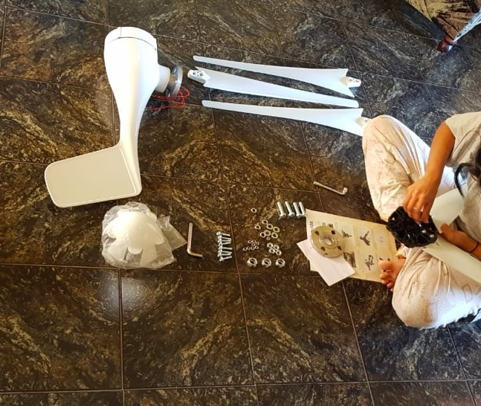
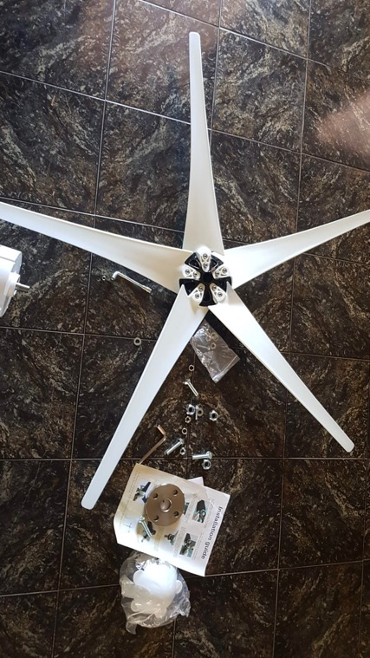
The Implementation
The wind turbine kit has been assembled and is yet to be mounted on a shaft of around 2m in height. After mounting, it will be connected to the grid along with the PV arrays to make up the hybrid system.

Slide 20
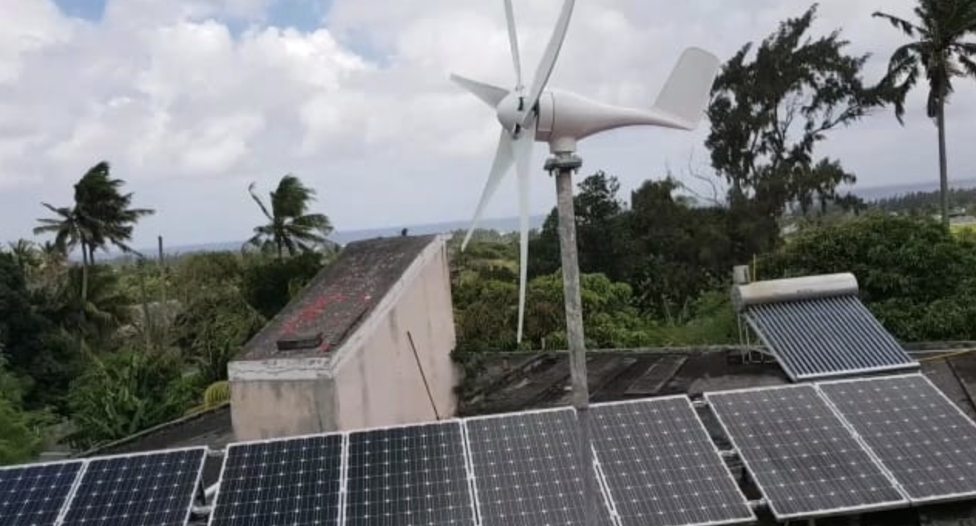
Check
Wind and Solar working properly
Decrease in Electricity Consumption

Slide 21
Act
Tiltable Pole
Safety Measures
Angle and direction of panels

Slide 22
01
Reduction in Electricity bill
02
Partial energy independency
Project
Outcomes
03
Reduce potential GHG emissions
04
Technological Innovation

Slide 23
Stakeholders
Omnicane
Université des Mascareignes
Green Peace
Rogers
Dream Art Academy
SFER-Société fournisseur d’énergies renouvables
Young African
Leaders Initiatives
National Productivity & Competitiveness Council

Slide 24
Scamper
Reverse
R
Put to other use
Eliminate
E
Substitute
Combine
Adapt
Modify
S
C
A
M
P
SCAMPER model

Slide 25
SUBSTITUTE – Fossil fuels to renewable sources of energy.
COMBINE – Use two different elements to create a hybrid system.
ADAPT - Adapting the hybrid system to fit into the roof of the concrete houses of middle-class families.
MODIFY – HAWT to VAWT
PUT TO OTHER USE - Using the hybrid system simultaneously to improve the environment by moving towards a greener, more sustainable island. Also meeting the UN SDGs. Aesthetically pleasing for homes.
ELIMINATE - Eliminating the dependency of our citizens on the electricity supply from the CEB (national grid). REVERSE / REARRANGE - Making the hybrid system smaller and lighter by using aluminum material.

Slide 26
Sustainability
In the long run, we are aiming for a scheme with the help of the government to help promote green energies.
In a global context, it helps Mauritius achiever the UN Sustainable Development Goals including Goals 7, 12 and 13.

Slide 27
Leadership
Leadership skills
Team spirit
Communication skills
Problem-solving skills
Critical thinking skills
Personal competence
Confidence and character

